Slide 1
3D Modelling
Photon Cloud
Texturing
Unity Native App (Oculus Quest/Desktop)
User Management
Game Engine
Multiplayer (Photon)
Skinning/Rigging
REST API (HTTPS)
AD Services
Physics Engine
Oculus SDK
Access/Privilege Management
Animation
Render Engine
Oculus Lip Sync Pipeline
CMS
KMS
LMS
Lighting & Compositing
Content
Choreographer
Backend Enterprise Systems
2D Content
Game Logic Scripts
PIMs
3D Content
Network Communicator
BI Systems
A/V Content
Authenticator*
E-Commerce Systems
Real-time Data Extractor
Cognitive Services
Backend optional components
Core Device Libraries and Frameworks
Cognitive AI
Managed KBs
*Authentication will be static-only for the PoC
Security Layer
STT/TTS Services

Slide 2
 | Storyboard for Windmill predictive maintenance DCX
1 | The user wears the AR/ VR glasses, and sees the 3D model of the Wind turbine (WT).
2 | The user pinpoints to the part of the wind turbine assembly he wants to examine.
3 | The attributes (specifications) are displayed of the selected WT asset component, e.g.
 | -Dimensions (user selectable scale, m or ft) -Make, model, OEM, Warranty (if any) -Rotor diameter (m), Blade swept area (sq. m), Blade length (m) -Type of wind generator -Tower heights (m or ft, user selectable) & type (Steel Tubular, Hybrid Lattice) -Rotational speed (rpm)
4 | The user wearing AR/ VR glasses can go around the WT 3D model to have a view from any direction he chooses to.
5 | The user can choose to open up the turbine casing to examine the gear box and generator components
6 | The user selects either the gear box or generator, and the attributes (specs) are displayed, e.g. gear ratio, structure, generator output (KW or MW), generator voltage (V), generator current (A), frequency (50 Hz or 60 Hz)
7 | The user should be able to start/ stop the wind turbine using virtual dashboard (replica of the actual control dashboard)
8 | Should be able to simulate wind conditions (speed and direction), and be able to manoeuvre the wind turbine rotor

Slide 3

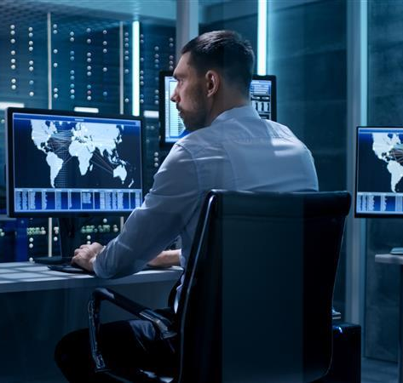
User Personas (1/2)
Fred
Field Inspector
Handles multiple windmills in a single inspection session
Very busy schedule
Timely inspection closures is very important for Fred
Mike
Maintenance expert with decades of service experience
Very busy schedule
Knows the in and out of maintaining state-of-the-art windmills

Slide 4
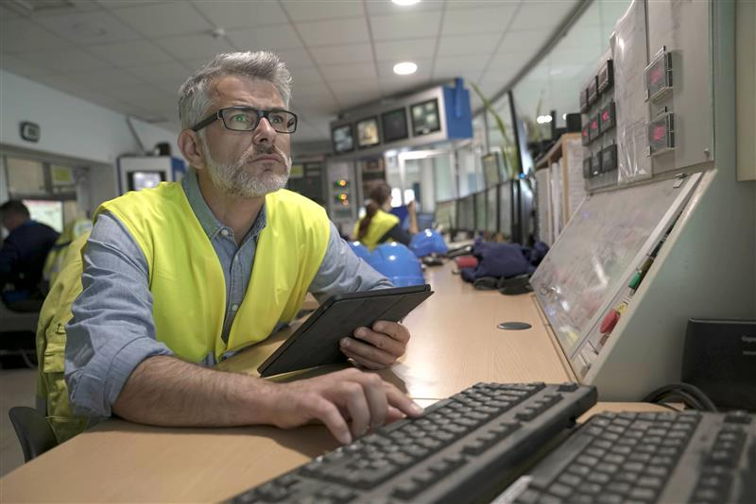
User Personas (2/2)
Abraham
Asset Expert
Has decades of experience in handling windmill assets and accessories
Very busy schedule
Caters to multiple sites and geographies
Must ensure that the right accessories are used in the right places

Slide 5
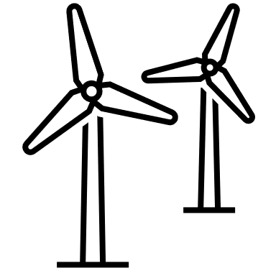
Scenario 1 – Exterior Inspection
Fred begins his daily windmill inspection, virtually through an Oculus Quest headset
He is transported into an immersive 3D metaverse which presents simulated Digital Twins of the Windmills he is trying to inspect
Fred analyses the structural damage(twisted blade) of the windmill. Fred raises a ticket on EAM and then allots and schedules a resource through ERP and WFM.
Fred selects the first windmill to inspect. He is presented with the exterior view of the windmill which he can zoom, pan and rotate to visualize all views to inspect individual exterior components
Dimensions (meter or feet)
Make, Model, OEM, Warranty (if any)
Rotor Diameter (m), Blade Sweep Area (sq. m), Blade Length (m)
Type of wind generator
Tower Height (m or ft) and Type (Steel Tubular, Hybrid Lattice)
Rotational Speed (rpm)

Slide 6
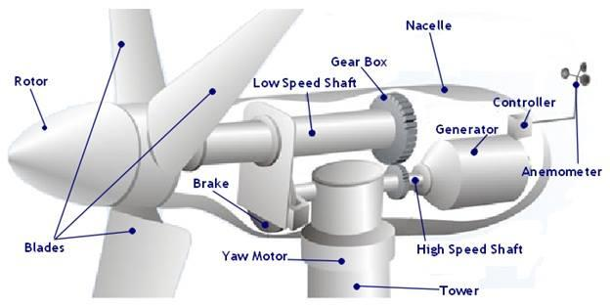
Scenario 2 – Interior Inspection 1
Fred then clicks on “take me in” and is transported to the windmill interiors where he can now control his 3D avatar to do a virtual inspection of the windmill interior components
Fred opens the turbine casing and examines the gear box and generator components.
Fred discovers that the gear box temperature is beyond acceptable limits and raises an alarm on EAM. Mike receives the alert and joins the metaverse session.
Fred selects either the gear box or generator, and the attributes are displayed on the panel through scada , e.g. gear box temp, bearing vibration , generator output (KW or MW), generator voltage (V)
Mike analyses the issue at hand and then advises the rectification steps to Fred. Fred raises a ticket on EAM and then allots and schedules a resource through ERP and WFM.

Slide 7

Scenario 3 – Interior Inspection 2
Fred notices that there is an anomaly in the bearing vibrations – the vibrations are way beyond the permissible range
Fred discusses on the issue with Mike (both the avatars interact with each other through voice and 3D interactions). Mike points out that this is a critical issue and suggests that they connect to an asset expert.
Fred raises a ticket on EAM and then allots and schedules a resource through ERP and WFM.
Mike initiates a call and adds Abraham into the metaverse. Abraham joins with his avatar and analyses the situation. Abraham then advises on the rectification steps.

Slide 8
05-Aug
19-Aug
02-Sep
16-Sep
26-Sep
W1
W2
W3
W4
W5
W6
W7
W8
W9
Initial Discovery
Storyboarding
Technical Architecture and Design
Environment and Team Setup
Choreographer Design
Real-time IoT Data Simulation – Data Adapters and Models
Multiplayer Interaction Design and Handling
Lip Sync Pipeline
Human motion handling
Testing
Preparing for Deployment
Technology and 3D art governance
XR Architect
Data Handling
Technology Governance
Model Refinements
Animation tweaks
3D Environment changes
Blueprinting
Initial 3D Exterior Models
2D Assets
Texturing, Material Design
Exterior Windmill animations
3D Environment Setup
Lighting, Compositing
Avatar Design and Animation
3D Artist
Environment Setup
Data Handling
Real-time IoT Simulator Development
3D Content Integration
Multiplayer Interactions and Events
Voice Communication
Human motion handler
Finalized 3D Environment Integration
Housekeeping and Optimizations
Testing
Integration Testing and Deployment
Sr. Unity Developer 1
Sr. Unity Developer 2
Environment Setup
Choreographer Development
3D Content Integration
Environment Composition
Avatar integration
Lip Sync Pipeline Development
Post Processing Effects
Housekeeping and Optimizations
Testing
Integration Testing and Deployment
Multiplayer UI, Room Setup and Connection Handling
Avatar animations -integration into Unity
Camera Motion and Transition
Sound FX Design
Multimedia Content Integration and Choreography
Dynamic Lighting and Real-time VFX
Environment Setup
2D UI Setup and Development
Development of Unity scriptable assets
Integration Testing and Deployment
Unity Developers (2)

